Slide 1
Your Large Vision-Language Model Only Needs
A Few Attention Heads For Visual Grounding
CVPR, 2025
9 citations
Yonsei University

Slide 2
01. INTRODUCTION
02. METHOD
03. EXPERIMENTS
04. LIMITATIONS

Slide 3

Visual Grounding
Localize the image region corresponding to a free-form text description
“Woman”
“Sunglasses”

Slide 4
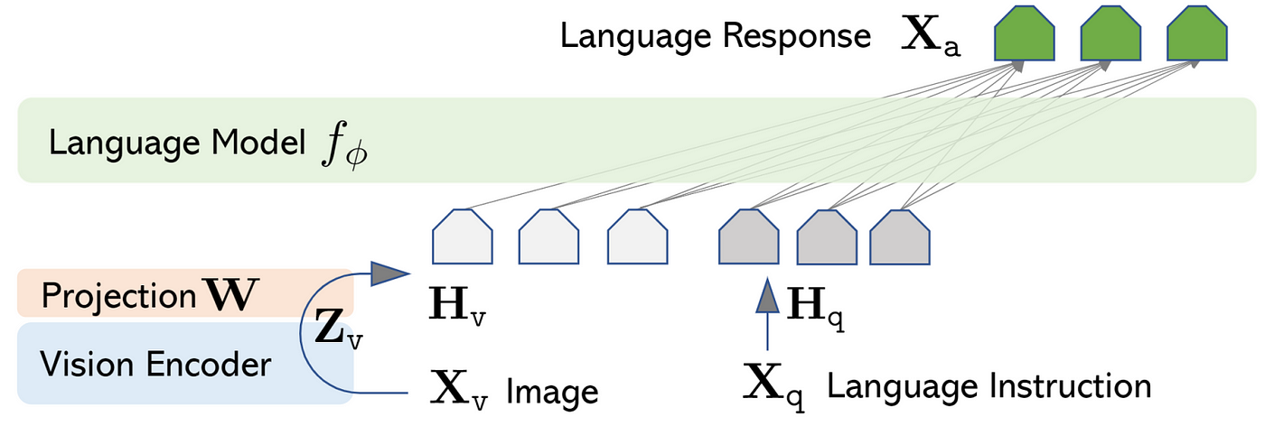
Large Vision-Language Models (LVLMs)
Consists of three components
Vision encoder: transform image to vision token
Projection: convert vision token into language token formats that LLM can understand
Language model (LLM): generates text by combining projected vision tokens with original text tokens

Slide 5
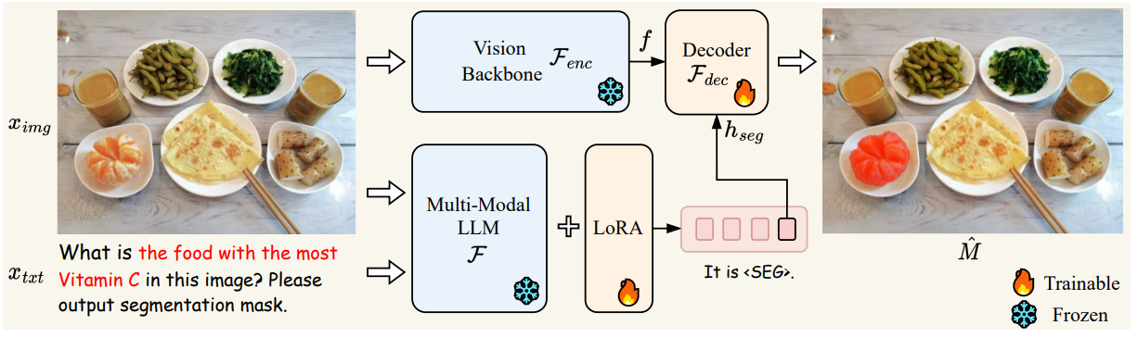
Problem Definition
Visual grounding has largely been addressed with the emergence of powerful LVLMs
It requires fine-tuning or additional model components to generate explicit bounding boxes and segmentation masks

Slide 6
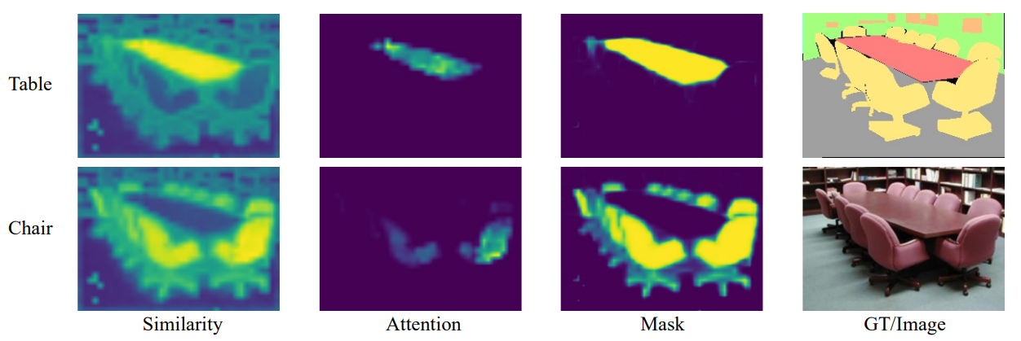
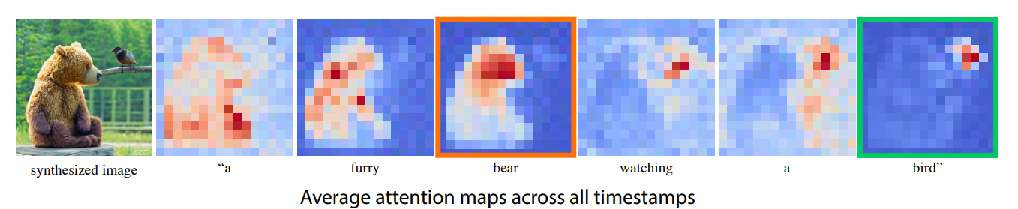
Motivation
ViTs and DMs capture text-related regions using attention maps
ViT
DM

Slide 7
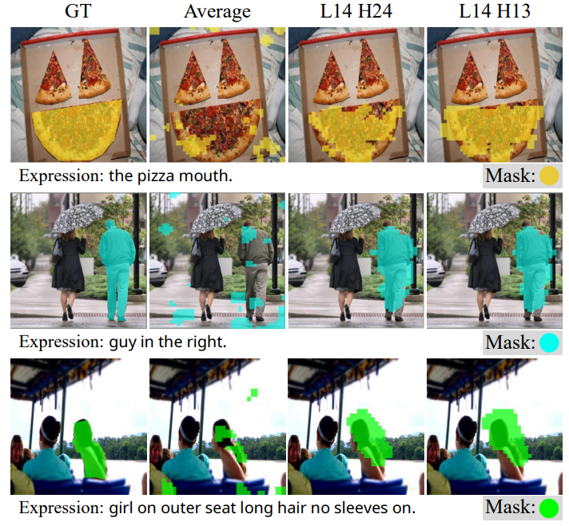
Objective
Propose a training-free LVLM framework to localize text-related regions using attention maps
Problem 2
However, unlike the interpretable attention patterns observed in ViTs or DMs, the text-to-image attention maps in LVLMs are sparse and contain significant noise

Slide 8
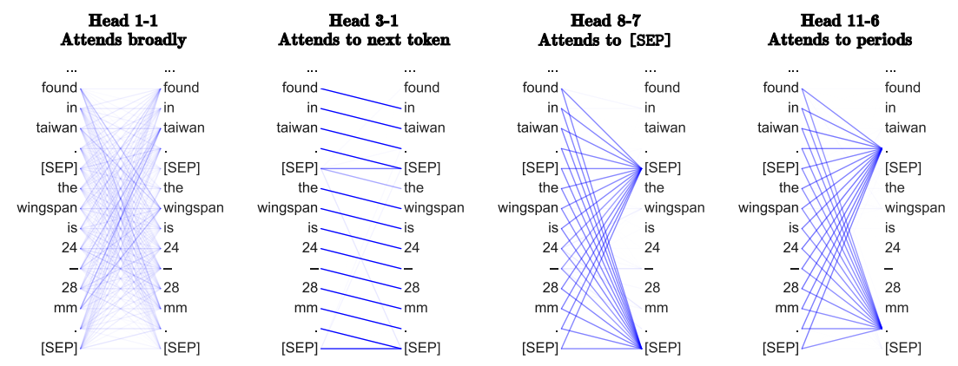
Motivation 2
Recent research shows the specific attention heads exhibit distinct characteristics (e.g., acting as localizer)

Slide 9
Objective
Propose a training-free LMLM framework to localize text-related regions by leveraging a few attention heads

Slide 10
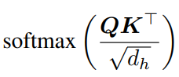
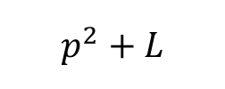
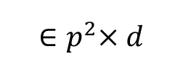
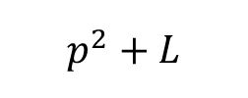

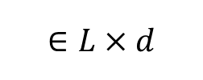
Background: Attention Map
$$∈(p^{2}+L)×d$$
$${∈p}^{2}×d$$
$$∈L×d$$
$$p^{2}+L$$
$$p^{2}+L$$

Slide 11
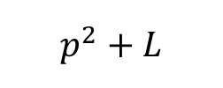
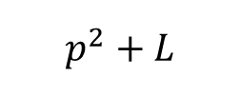

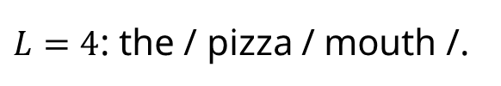
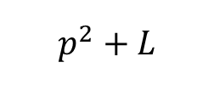
Background: Attention Map
Text: “the pizza mouth.”
$$p^{2}+L$$
$L=4$: the / pizza / mouth /.
$$p^{2}+L$$
mouth
.
$$p^{2}$$
$$p^{2}+L$$
.
.
Attention scores indicating text-image interactions

Slide 12
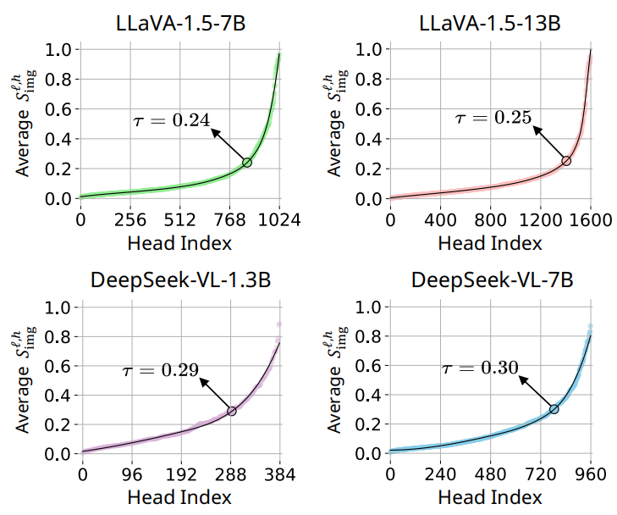

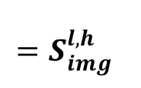


$$p^{2}$$
.
Criteria 1: Attention Sum
Identify heads that pre-dominantly focus on the overall image
1,000 random samples from RefCOCO training set
$$p^{2}$$
.
$$Sum( )$$
$$=S_{img}^{l,h}$$

Slide 13
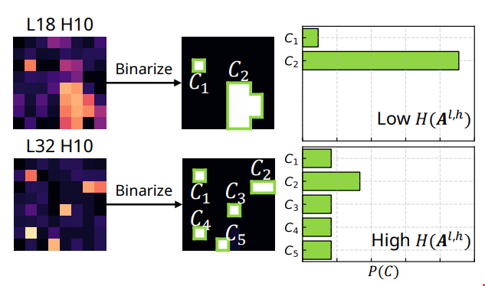
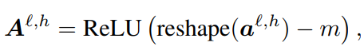
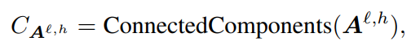
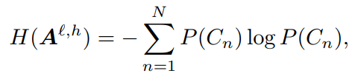


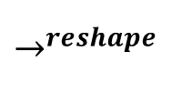

$$p^{2}$$
.
Criteria 2: Spatial Entropy
Identify heads that focus on objects
$$p$$
$$p^{2}$$
.
$$→^{reshape}$$
$$p$$

Slide 14
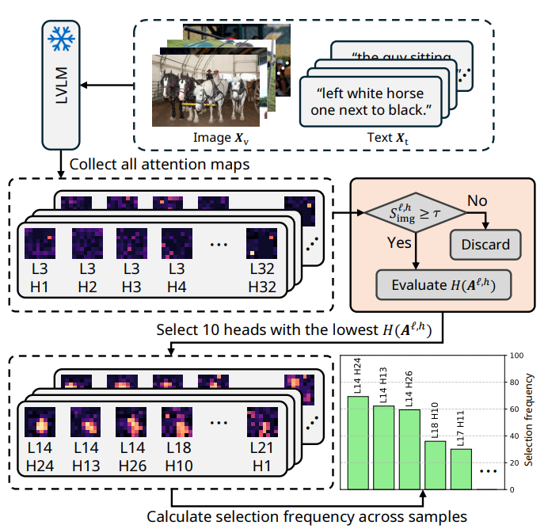
Finding localization heads via Criteria
1,000 random samples from RefCOCO training

Slide 15
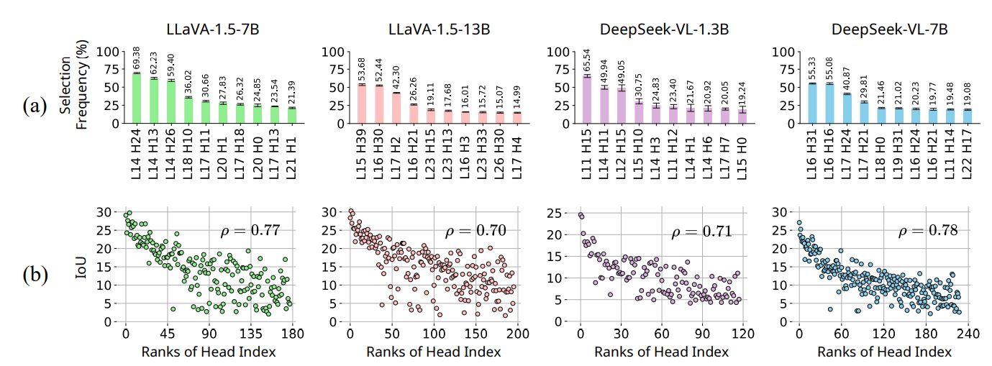
Finding localization heads via Criteria
Assign ranks to each head based on their selection frequency

Slide 16
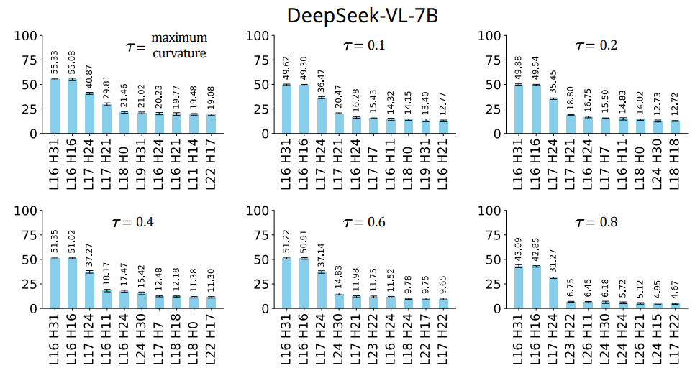
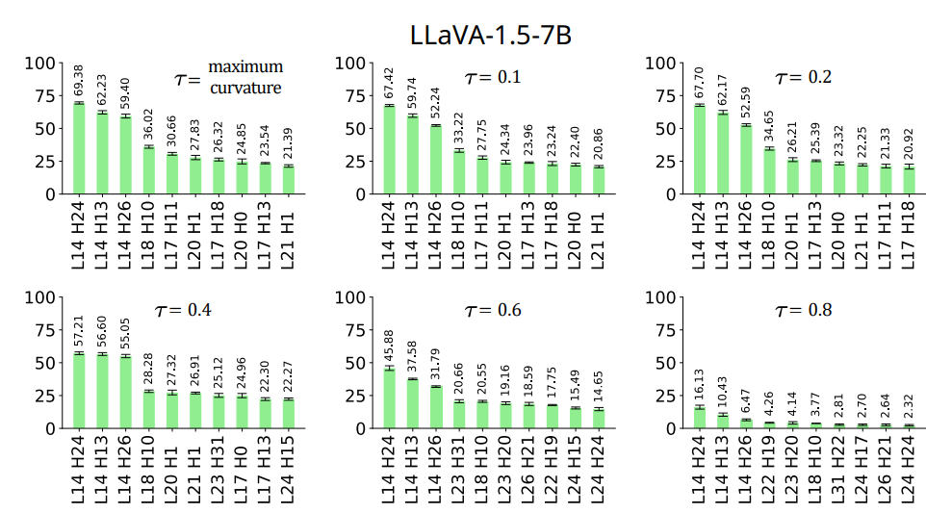
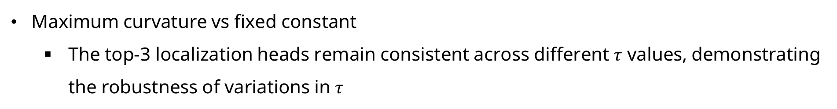
$$p^{2}$$
.
Criteria 1: Attention Sum
Maximum curvature vs fixed constant
The top-3 localization heads remain consistent across different $τ$ values, demonstrating the robustness of variations in $τ$

Slide 17
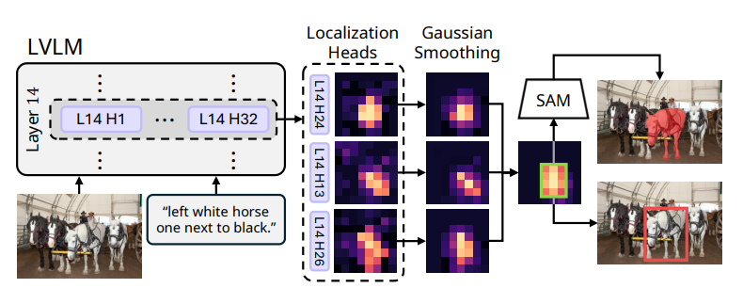
Visual Grounding with Localization Heads
Localization heads: top-3 heads
Apply Gaussian smoothing to minimize potential random noise
Element-wise summation and binarize

Slide 18
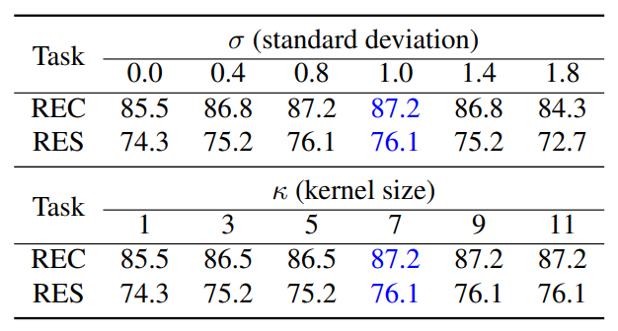
Visual Grounding with Localization Heads
Gaussian smoothing
Default: Kernel size 7, standard deviation 1.0
It consistently improves performance in most cases

Slide 19
Setting
Eval
REC: bounding box
RES: pixel-level segmentation mask
Dataset: RefCOCO, RefCOCO+, RefCOCOg

Slide 20
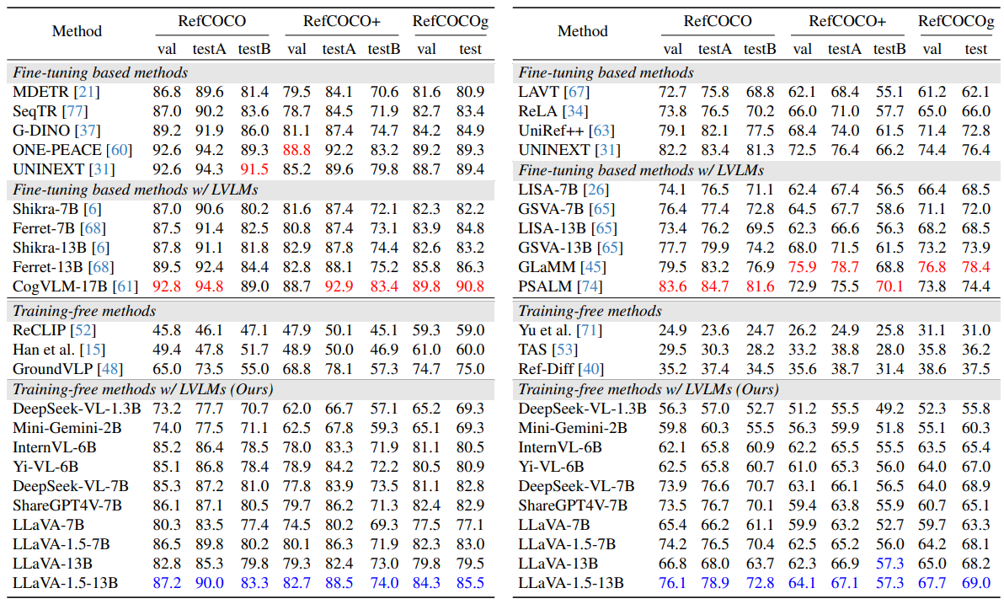
REC & RES

Slide 21
REC & RES

Slide 22
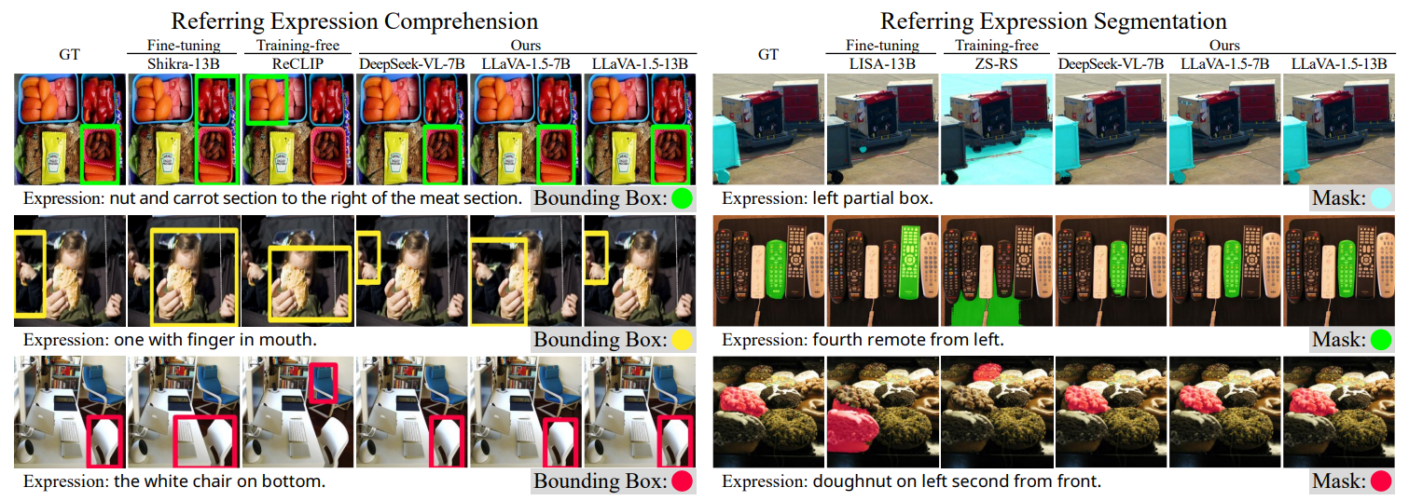
REC & RES

Slide 23
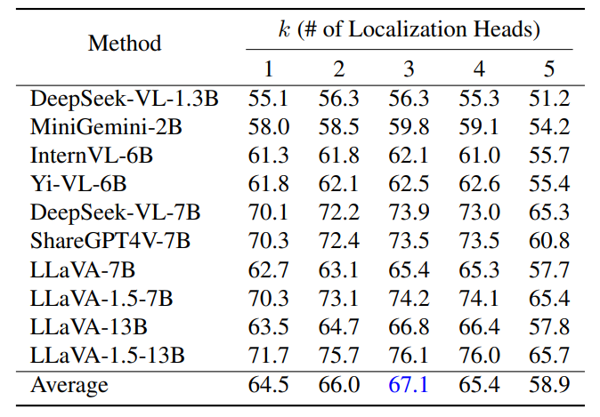
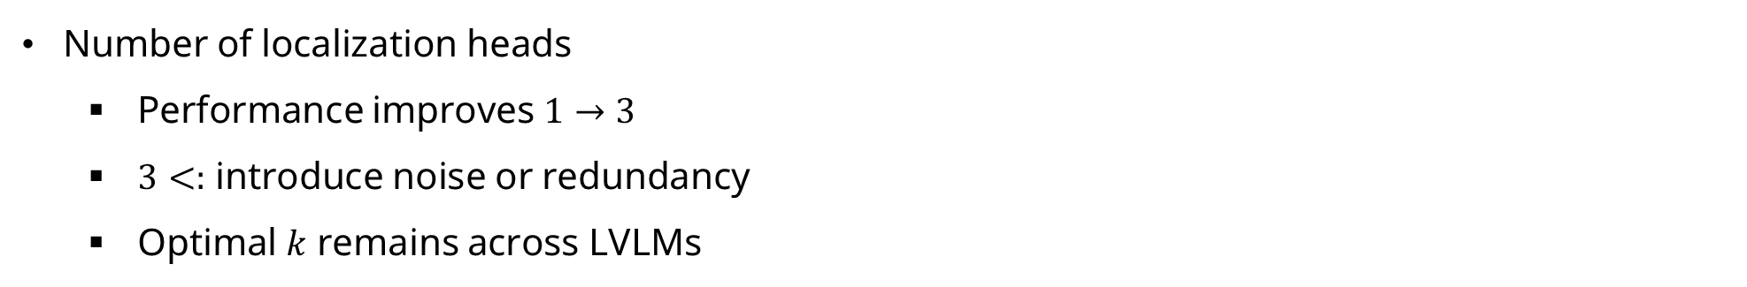
Ablation Study
Number of localization heads
Performance improves $1→3$
$3<:$ introduce noise or redundancy
Optimal $k$ remains across LVLMs

Slide 24
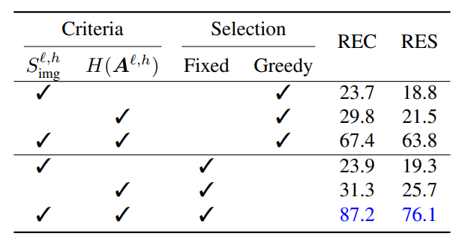
Ablation Study
Validation of criteria and selection methods
Fixed: selection frequency (1,000 samples)
Greedy: per sample

Slide 25
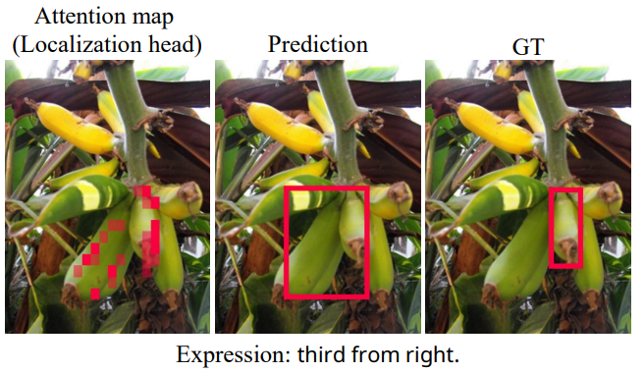
Failure case
The model fails to predict the correct object
LVLMs struggle with pinpointing the exact location of objects

